Slide 1

Electric Vehicle Price Prediction
--- Chetan Phartale ( PGA Batch 34 )

Slide 2
Introduction
Around 1832, Robert Anderson develops the first crude electric vehicle.
After 1870s electric cars became practical.
In 2021 almost 2332 thousand electric cars were sold in the Europe.
Europe accounts for 27.94% sale of electric cars.
The Electric Vehicles market in in Europe is projected to grow by 17.78% (2022-2027).
Resulting in a market volume of US$340.70bn in 2027.

Slide 3
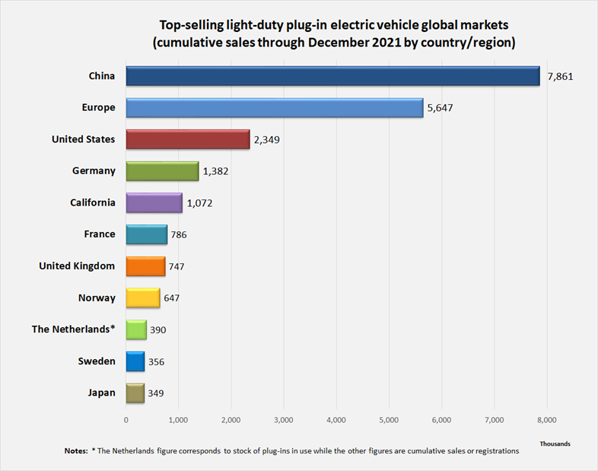
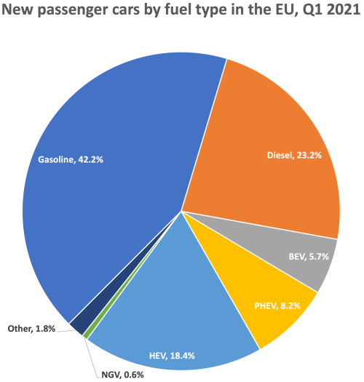
EVs encounter total of 32.3% market share in Europe.
Europe Is the second largest market for EVs.

Slide 4


Objective
The main objective of the project is to predict cost of electric vehicle based on Power transmission, Segment type, Range and Acceleration per second.

Slide 5
Data Source
The data is taken from Kaggle depository.
The data is based on Europe.
Here is link :-
https://www.kaggle.com/datasets/kkhandekar/cheapest-electric-cars
Data description
Numerical Variable | Categorical variable | dependent variable (Y)
AccelSec, TopSpeed_KmH, FastCharge_KmH, Range_Km, Efficiency_WhKm, Seats | Brand, Model,, RapidCharge, PowerTrain, PlugType, BodyStyle, Segment | PriceEuro

Slide 6
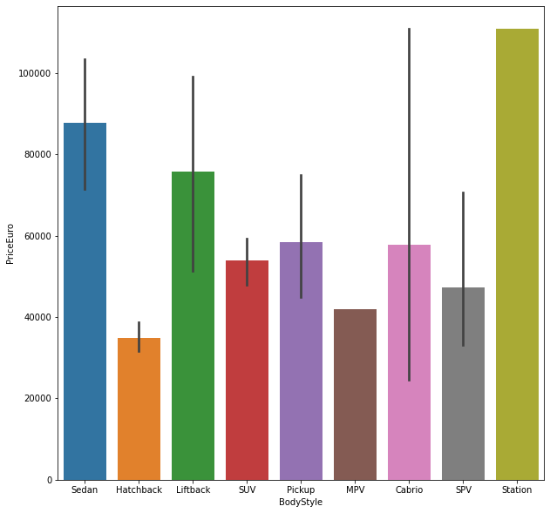
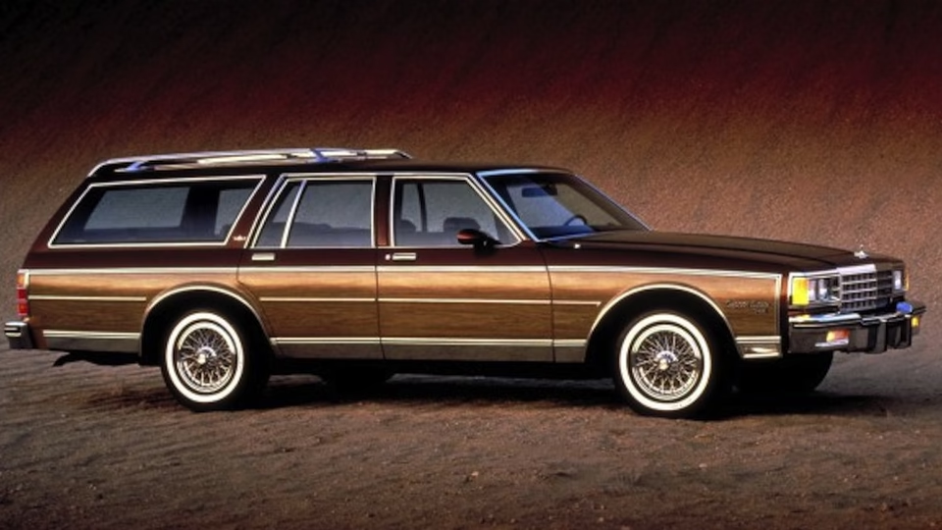
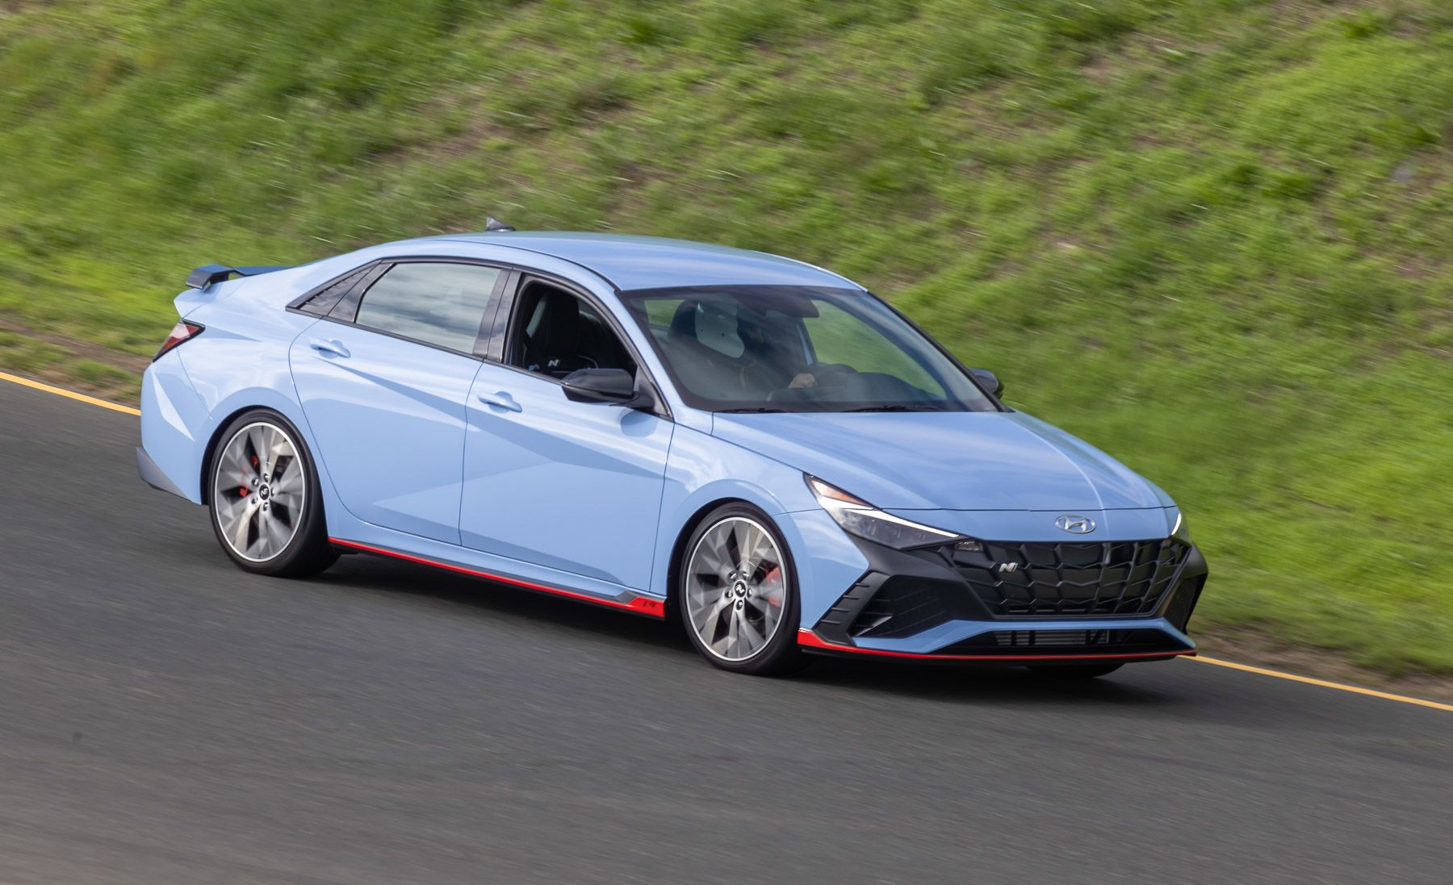
Data visualization

Slide 7
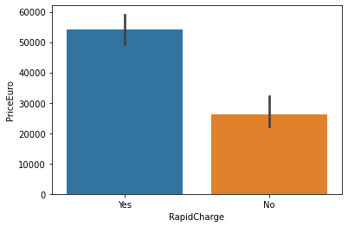
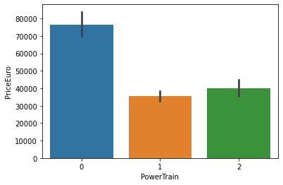
Data visualization

Slide 8
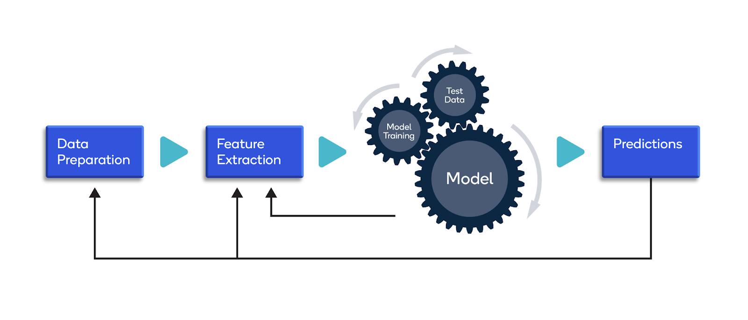
Project Workflow

Slide 9
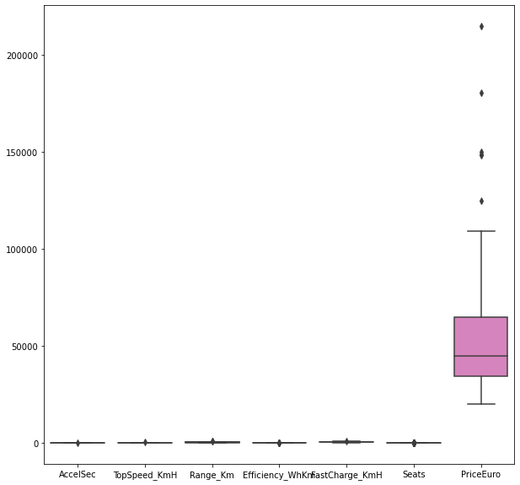
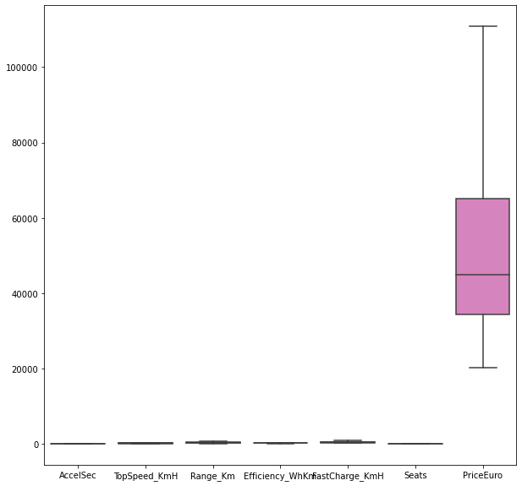
EDA
Outliers: The outliers which were present in the data are treated with Winsorizing method. (Alternate Method: Capping & Flooring)
Missing Values: The missing values are replaced with mean, median & mode. (Alternate method KNN Imputer)

Slide 10
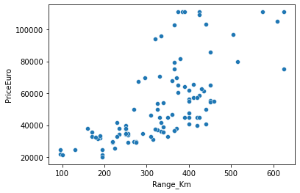
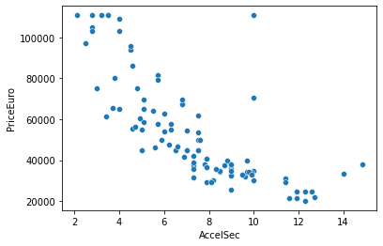
Data visualization

Slide 11
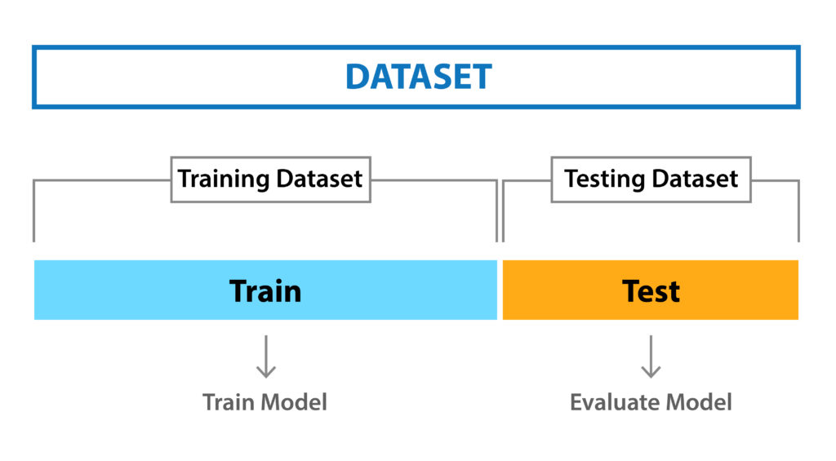
Data partition
Firstly all the categorical data is converted into numerical using Label Encoder. (Alternate Method: dummies, 1 hot incoder)
After conversion the partition is done using ‘train_test_split’ from Sklearn library.
70% data is kept in train, whereas 30% is used for test.

Slide 12
Machine Learning model
To perform the machine learning ‘Random Forest regression’ Model is used.
After performing grid search we have used the best parameters for pruning
Number of trees are 20.
Min sample split is kept as 5.
Min leaf split is kept as 3.
And number of braches are assigned as 3.

Slide 13
Model train & test accuracy
We performed various machine learning models on this dataset.
As the accuracy of Random Forest model is satisfactory for both train and test data, we chose results of that model to present.
Model | Train accuracy | Test Accuracy
Decision Tree | 86% | 80%
Random Forest | 90% | 84%
Gradient Boosting | 82% | 79%

Slide 14
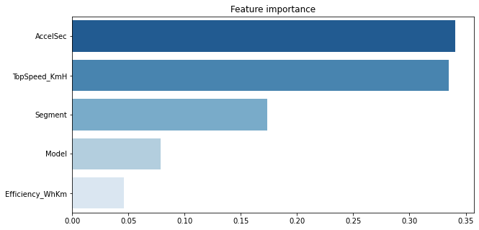
Important variables
Top 5 important variables for this analysis are.

Slide 15
Challenges
Time management
Data collection :- not many electric vehicles are present in the market.
Total Time Utilized = 20 days
Data Collection = 2 days
Data Preprocessing = 10 days
ML Model application = 6 days
Analysis = 2 days

Slide 16
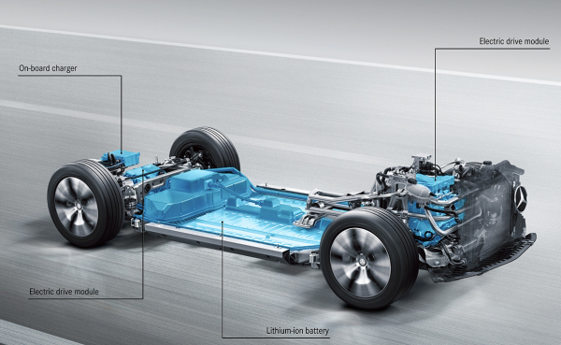
Conclusion
Based on data visualization we conclude that car price can be impacted by, Range, motors type, rapid charge, Acceleration/sec.
Model can predict the price of car with 90% accuracy.
Model can be used by a customer to predict price of a car using its features.

Slide 17
Suggestion
An advance model can be used by Car manufacturing companies to analyse better relationship between features & their effects on vehicle price & accordingly undergo further modifications.

Slide 18


